Slide 1

New York Housing Market
Paweł Florek, Krzysztof Adamczyk

Slide 2

Stages:
EDA
Data processing
Models
Cross-validation and hyperparameters
AutoML – TPOT
Voting and Stacking
Explainable AI

Slide 3
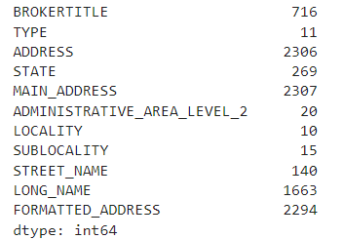
EDA – base info
Nulls => 0
Duplicates => 97
Unique values in cat_cols:

Slide 4
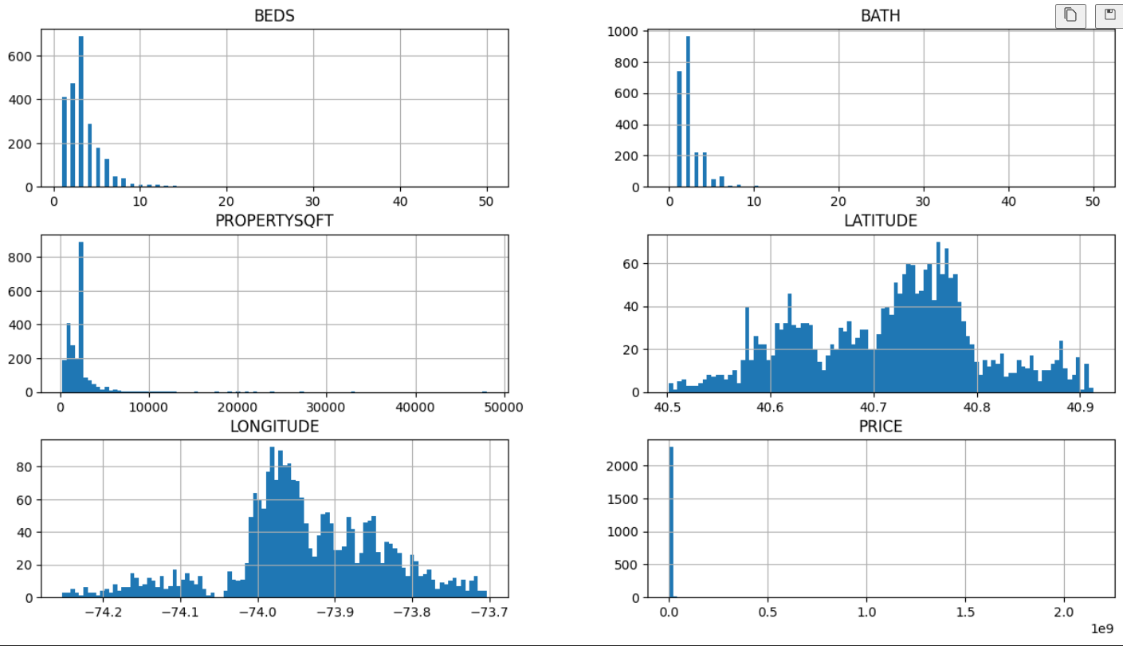
EDA – barplot for num_cols

Slide 5
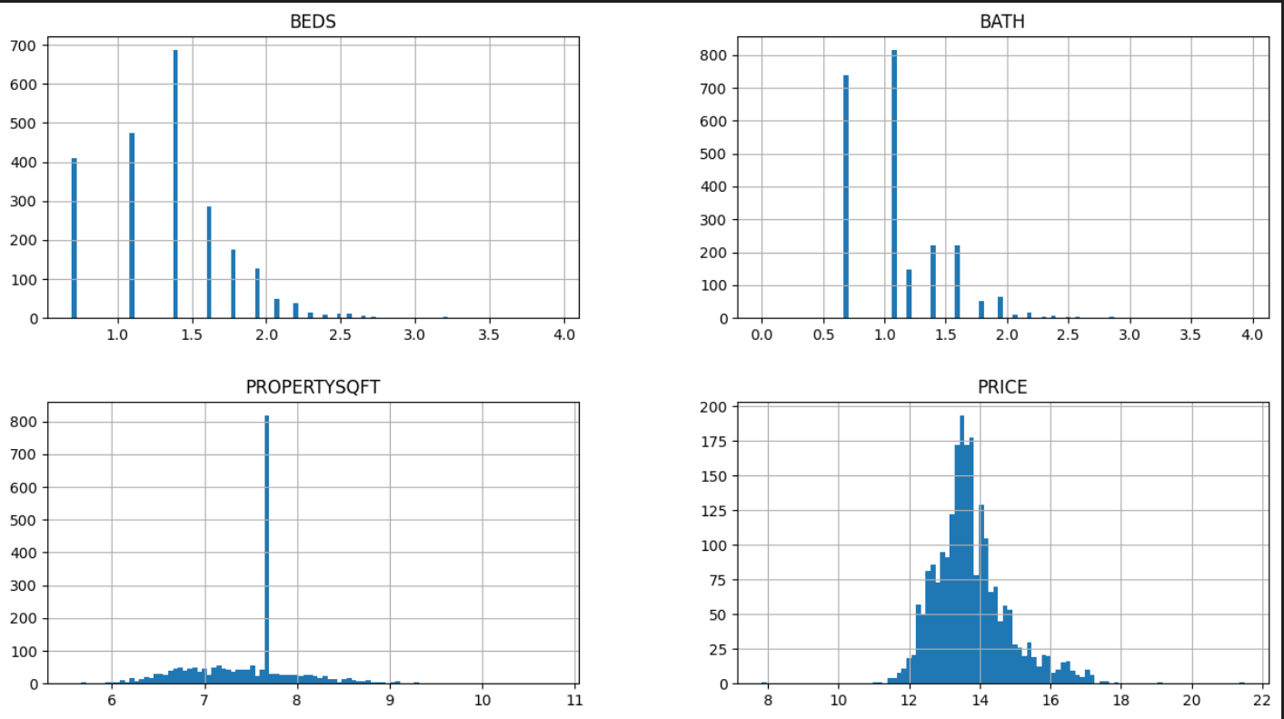
EDA – barplot for log scalled num_cols

Slide 6
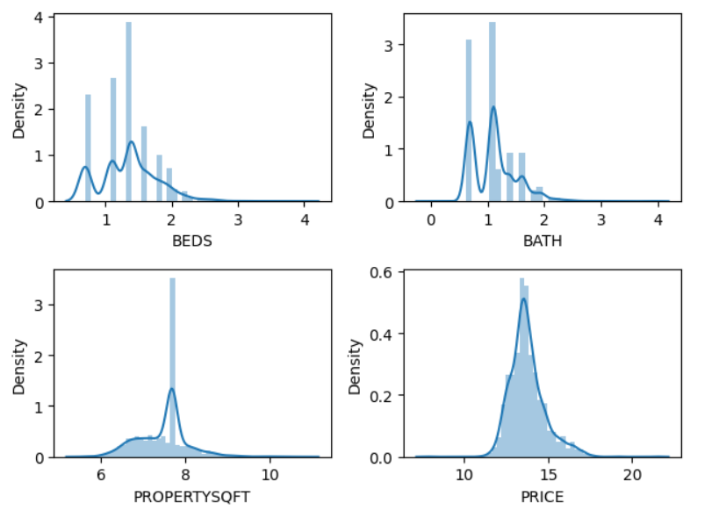
EDA – Density of num_cols

Slide 7
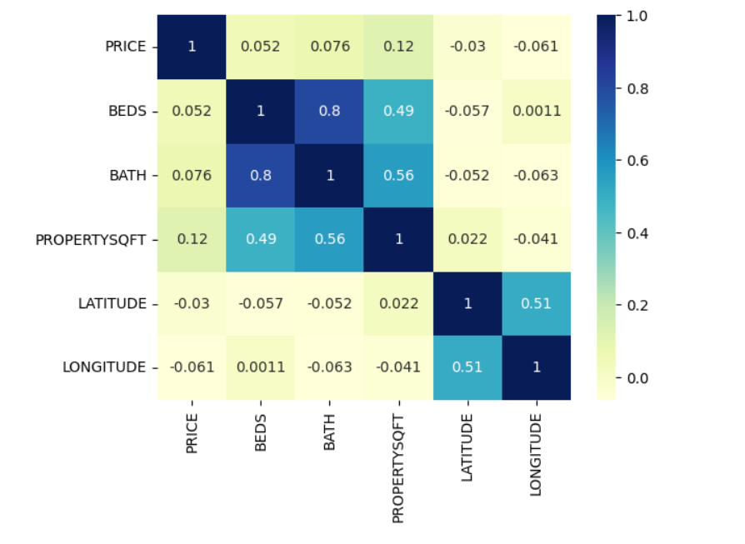
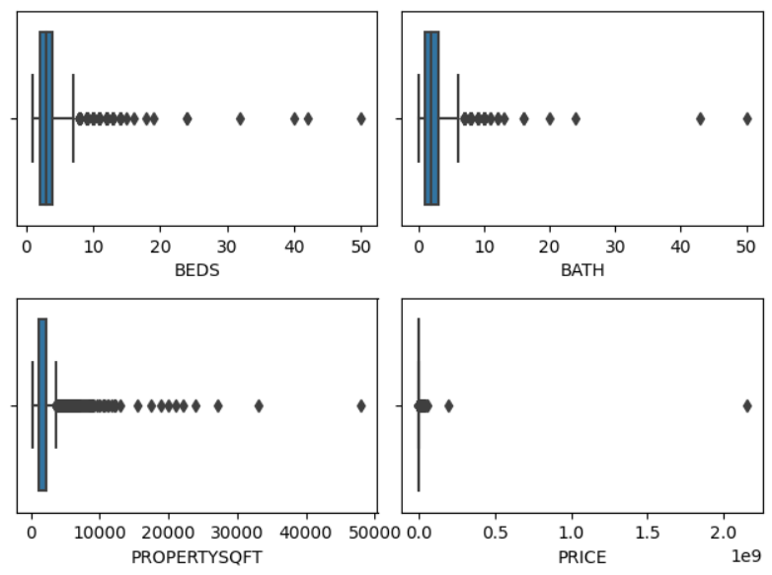
EDA – boxplot and corr() for num_cols

Slide 8
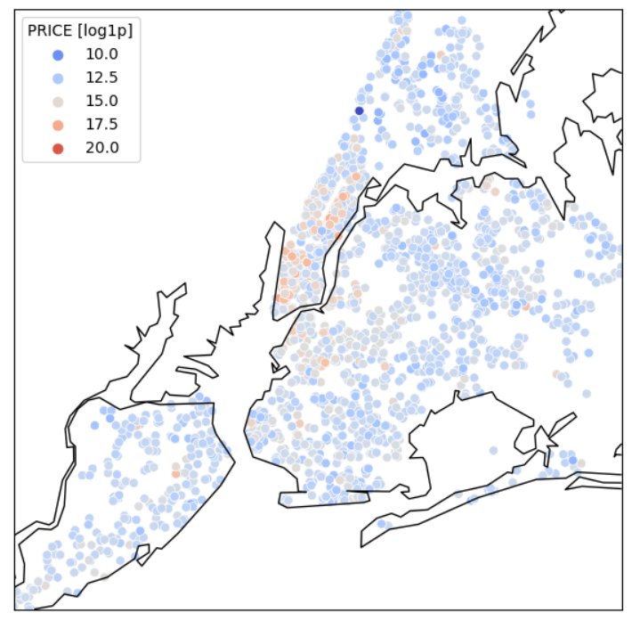
EDA - map

Slide 9
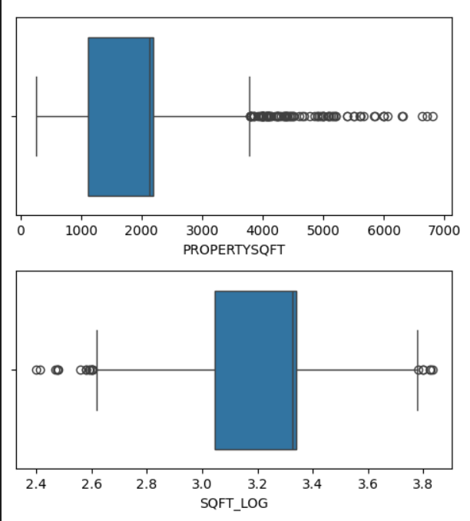
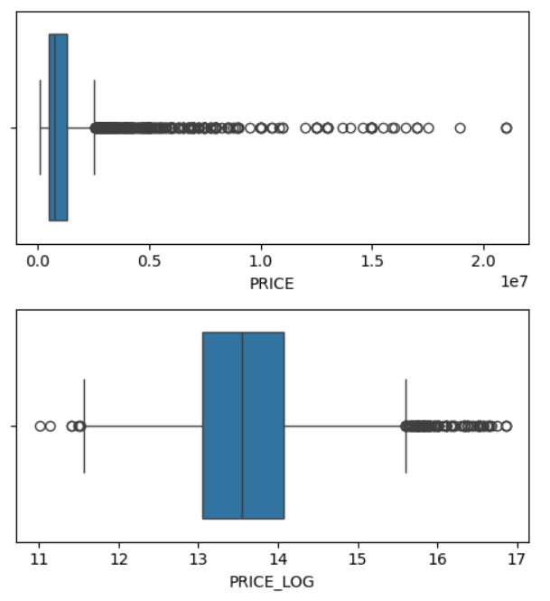
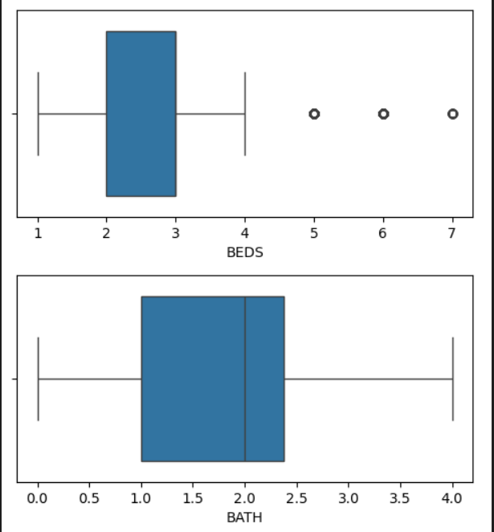
Data processing - outliers

Slide 10
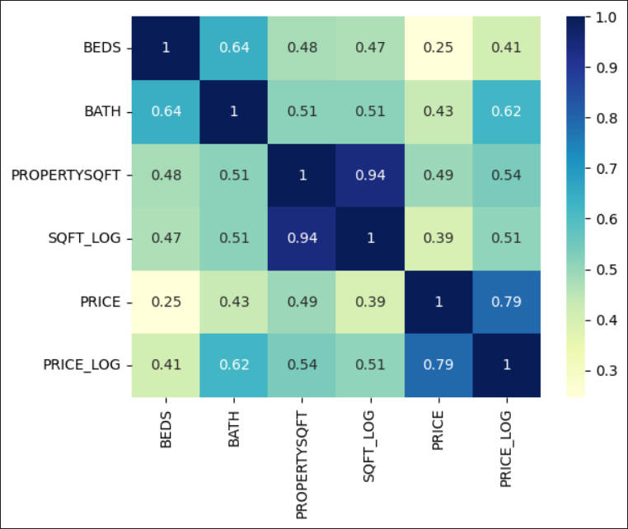
Data processing- corr()

Slide 11
Data processing - groupping
Liczba ZIPCODE występujących jednokrotnie: 8
Liczba SUBLOCALITY występujących jednokrotnie: 3
Liczba BROKERTITLE występujących jednokrotnie: 438
Liczba TYPE występujących jednokrotnie: 2
BROKERTITLE .value_counts() == 1: => „Others”: redukcja do 372 obserwacji

Slide 12
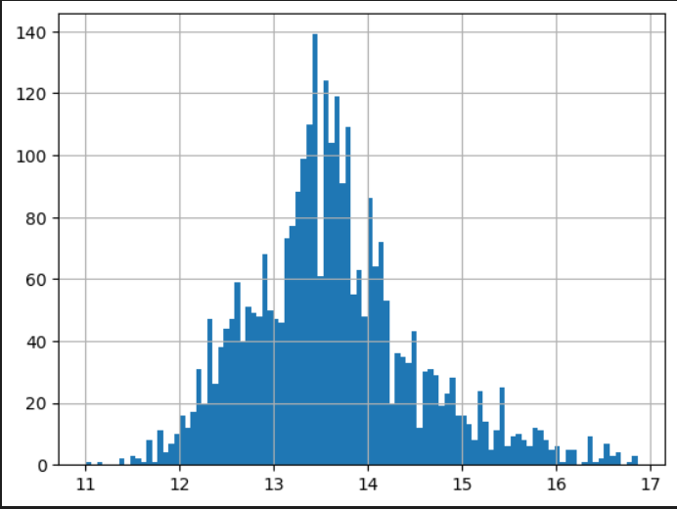
Data processing – price categories
Cheap: Price_log <= 13.0
Mid: Price_log > 13.0 and Price_log <= 14.5
Expensive: Price_log > 14.5

Slide 13
Data processing - encoding
Target Encoder: "SUBLOCALITY", "TYPE", "ZIPCODE", "BROKERTITLE".
Standad Scaller: "BEDS", "BATH", "SQFT_LOG", "LATITUDE", "LONGITUDE"
Target: Price_Category: Cheap = 0, Mid = 1, Expensive = 2

Slide 14
Models after c-v and hyperparameters
Logistic Regression: Best: 0.802715 using {'max_iter': 100000}
Decision Tree Classifier: Best: 0.806001 using {'ccp_alpha': 0, 'criterion': 'gini', 'max_depth': 6, 'max_features': 'sqrt'}
SVC: Best: 0.824947 using {'C': 100, 'degree': 1, 'gamma': 0.01}
KNeighbors Classiefier: Best: 0.829078 using {'metric': 'cosine', 'n_neighbors': 7, 'weights': 'uniform'}
Random Forest Classifier: Best: 0.835249 using {'n_estimators': 100, 'max_features': 'log2', 'max_depth': 5, 'criterion': 'log_loss'}
Gradient Boosting Classifier: Best: 0.857494 using {'n_estimators': 500, 'max_features': 'sqrt', 'max_depth': 6, 'loss': 'log_loss', 'learning_rate': 0.05, 'criterion': 'friedman_mse'}

Slide 15
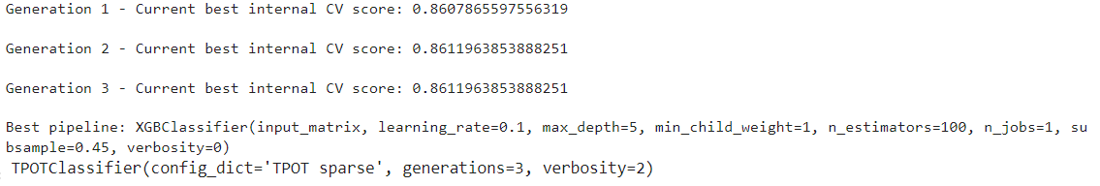
AutoML - TPOT

Slide 16
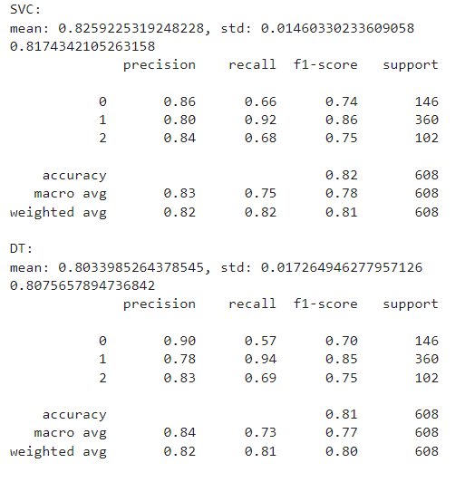
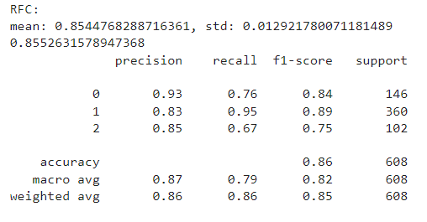
Models

Slide 17
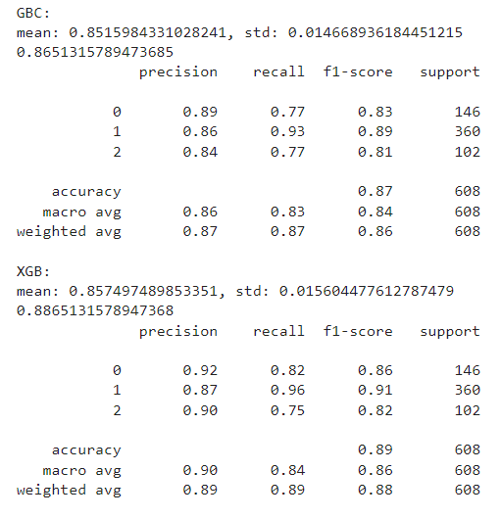
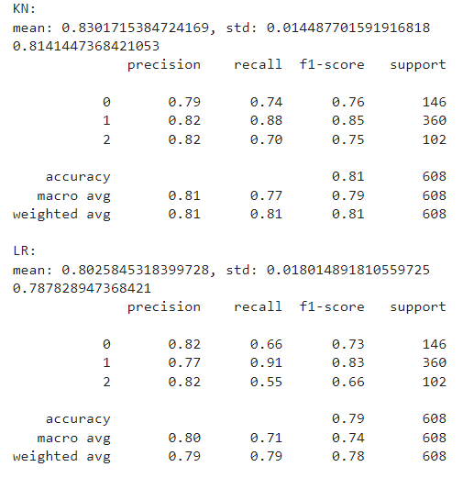
Models

Slide 18
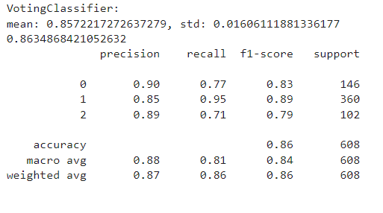
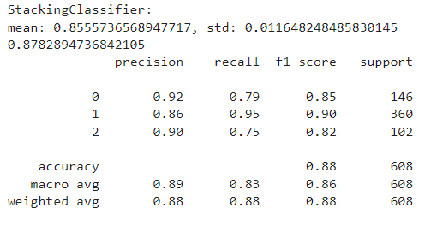
Max Voting and Stacking

Slide 19
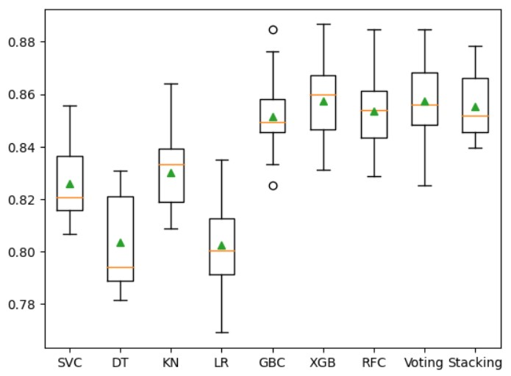
Comparision of model results

Slide 20
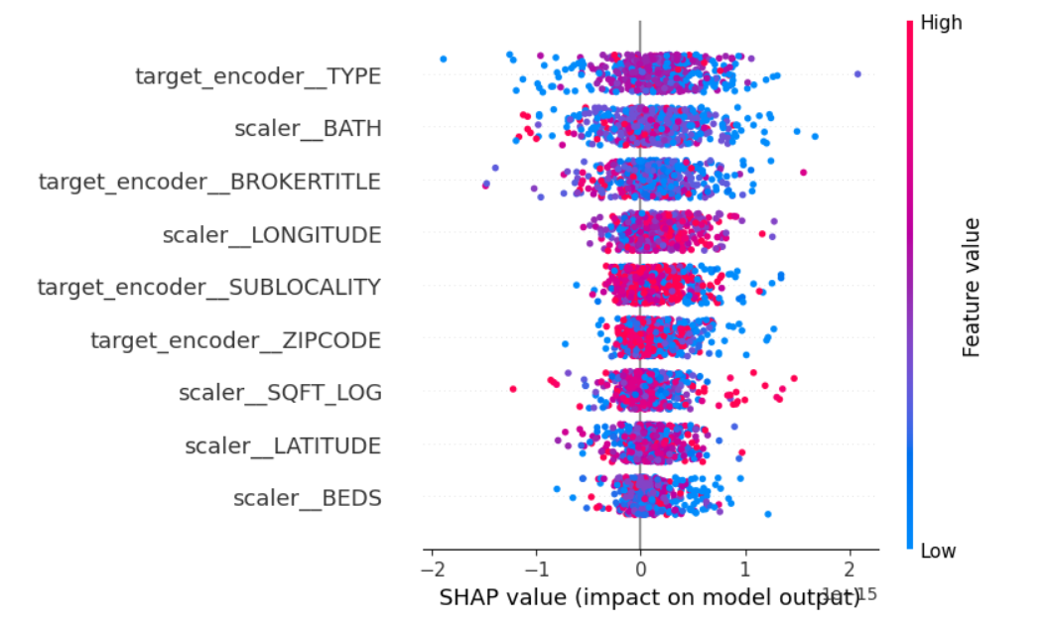
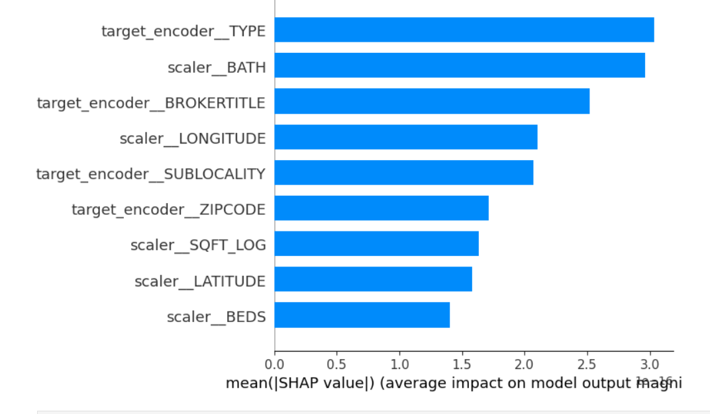
Explainable AI -shap

Slide 21
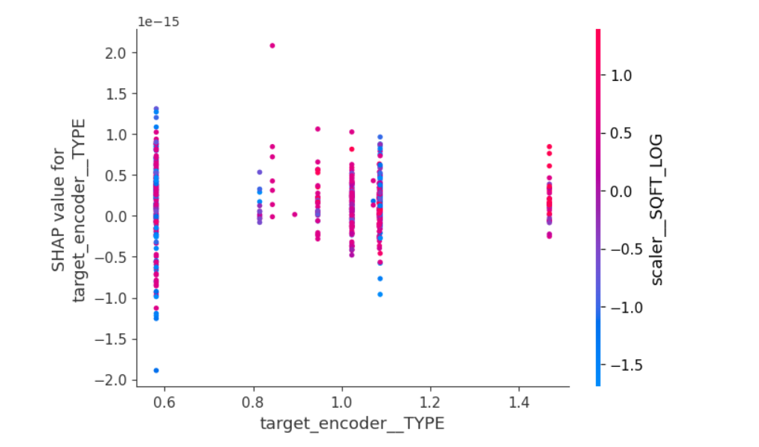
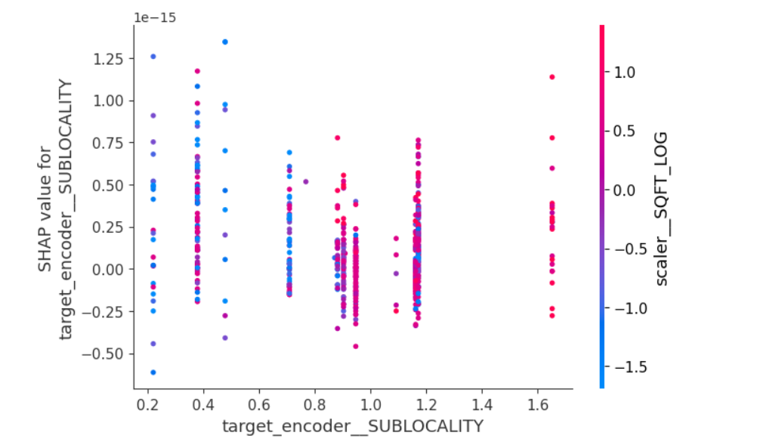
Explainable AI - details

Slide 22
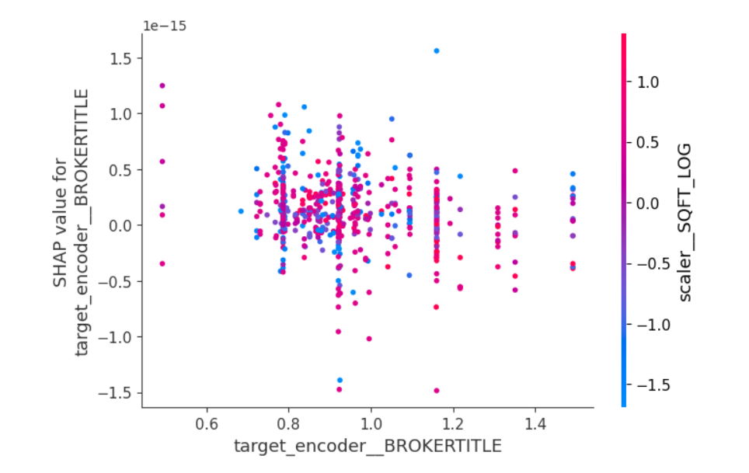
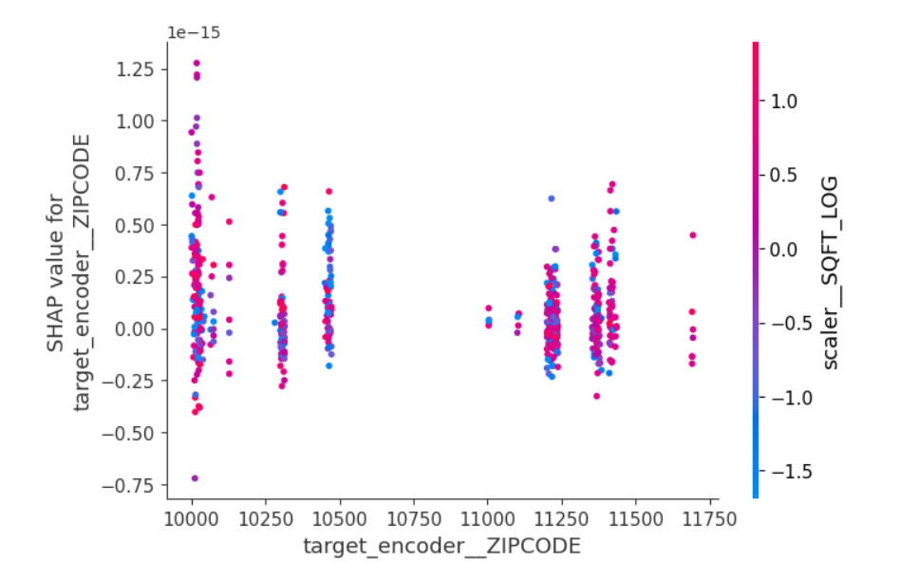
Explainable AI - details

Slide 23
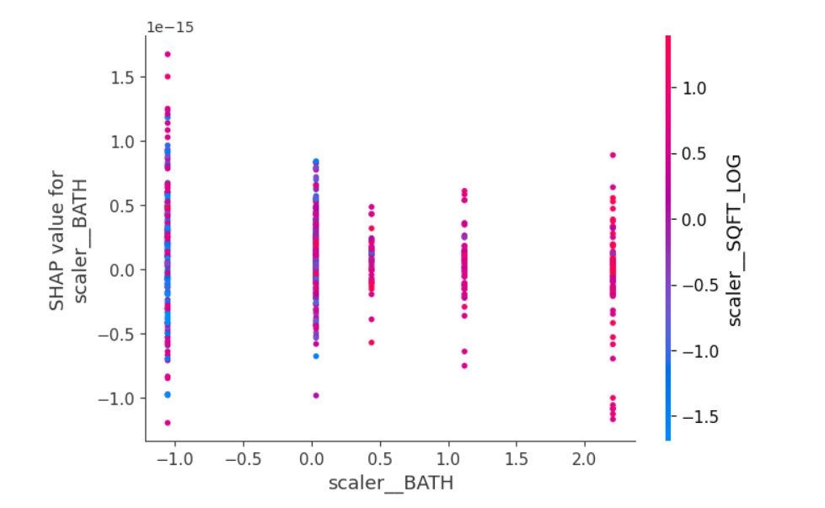
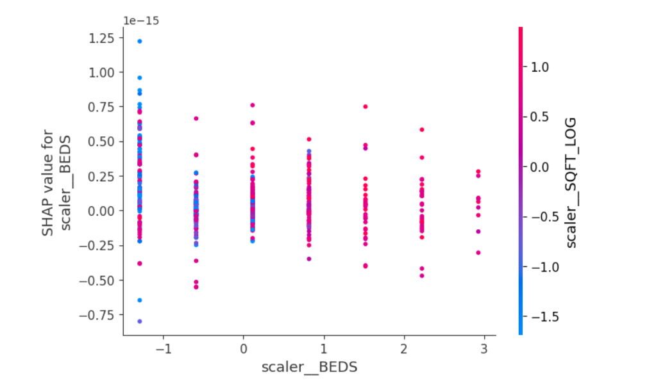
Explainable AI - details

Slide 24
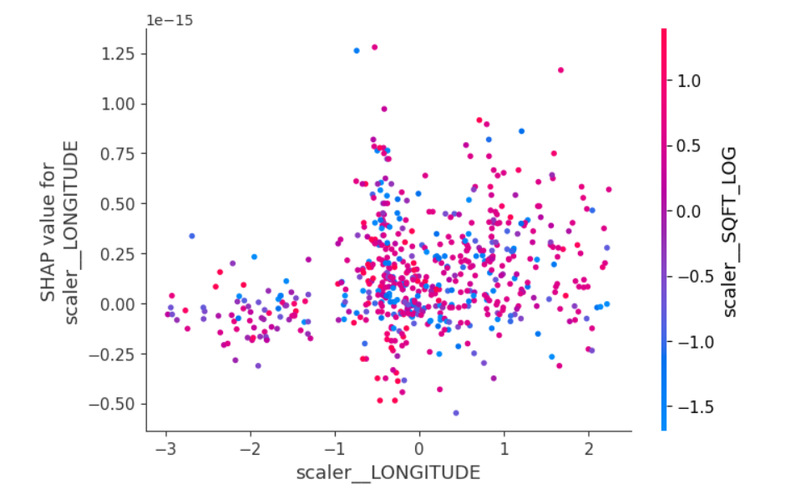
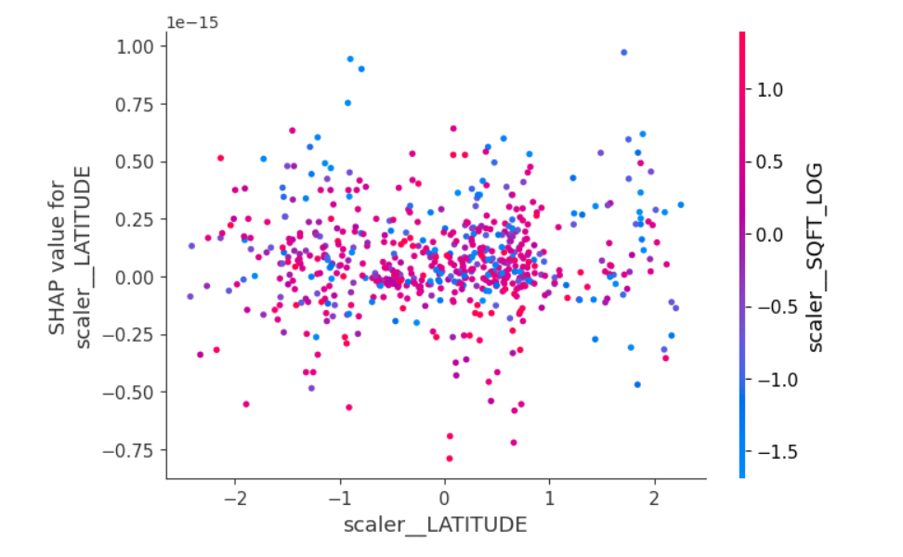
Explainable AI - details

Slide 25
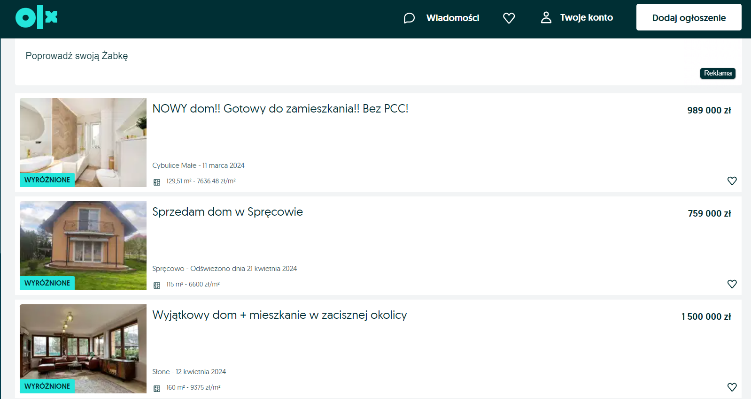


Usage of model

Slide 26

Thanks for watching

